Slide 1
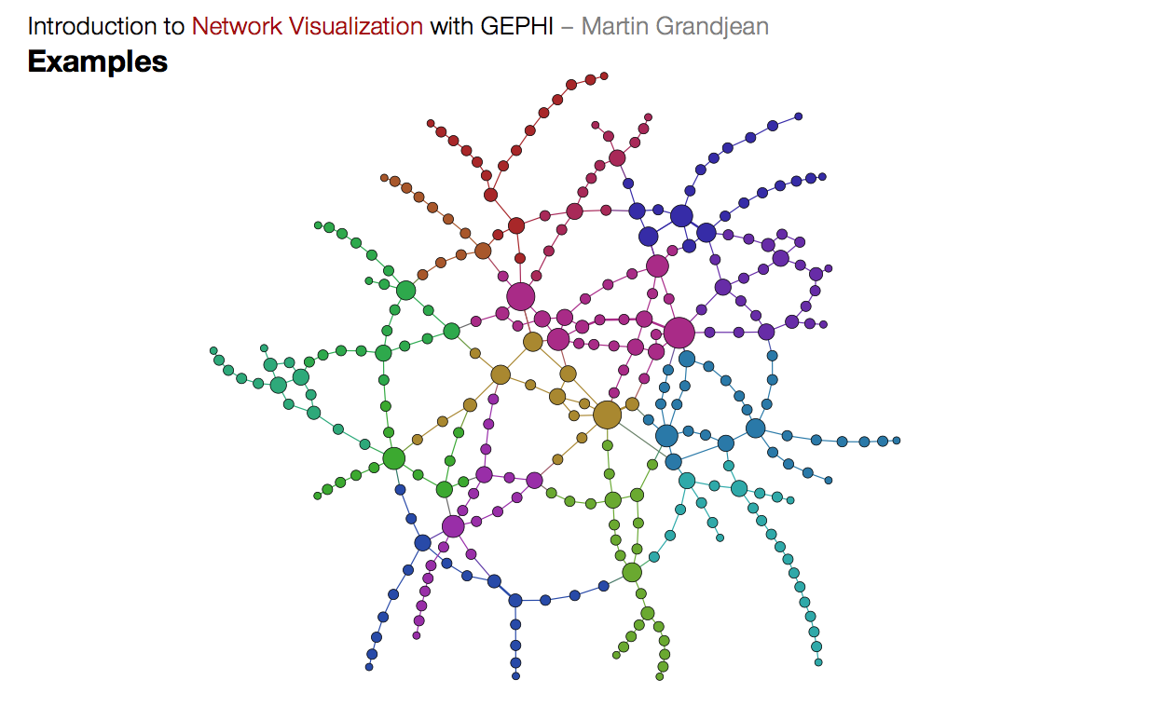
Graphs and Traversals
Lecture 22 (Graphs 1)
CS61B, Spring 2024 @ UC Berkeley
Slides credit: Josh Hug

Slide 2
Tree Definition
Trees
Tree Definition
Tree Traversals
Usefulness of Tree Traversals
Graphs
Graph Definition
Some Famous Graph Problems
Graph Traversals
Motivation: s-t Connectivity
Depth First Search
Tree vs. Graph Traversals
Challenge: Invent Breadth First Search
Lecture 22, CS61B, Spring 2024

Slide 3
Tree Definition (Reminder)
A tree consists of:
A set of nodes.
A set of edges that connect those nodes.
Constraint: There is exactly one path between any two nodes.
Green structures below are trees. Pink ones are not.

Slide 4
Rooted Trees Definition (Reminder)
A rooted tree is a tree where we’ve chosen one node as the “root”.
Every node N except the root has exactly one parent, defined as the first node on the path from N to the root.
A node with no child is called a leaf.
A
A
A
For each of these:
A is the root.
B is a child of A. (and C of B)
A is a parent of B. (and B of C)
B
B
B
C
C
C
C

Slide 5
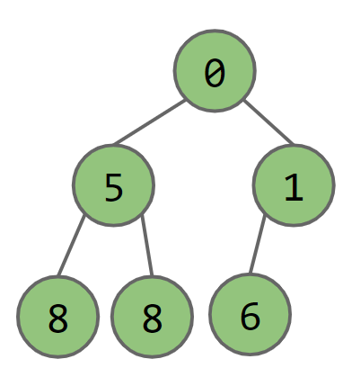
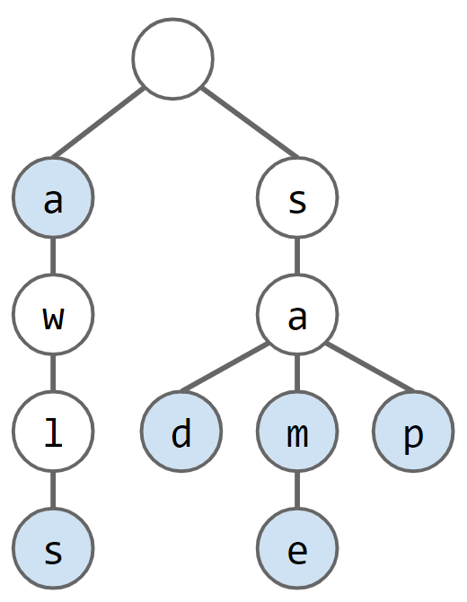
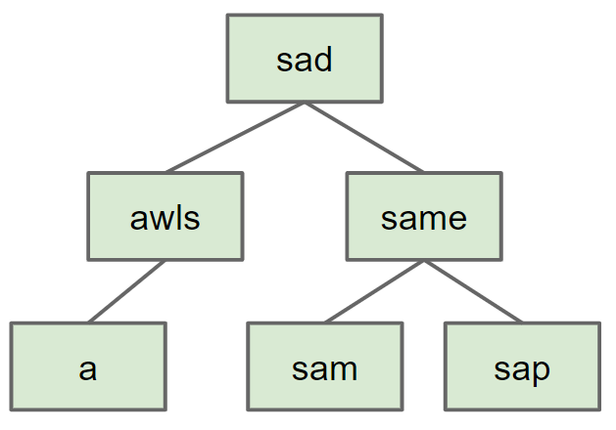
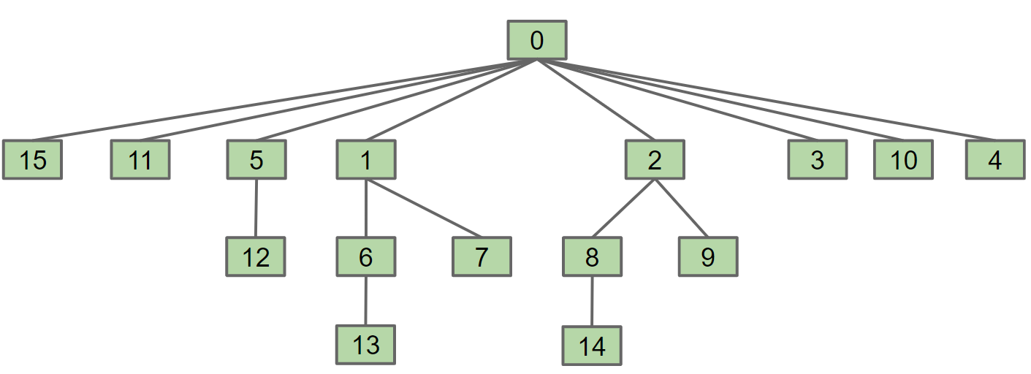
Trees
We’ve seen trees as nodes in a specific data structure implementation: Search Trees, Tries, Heaps, Disjoint Sets, etc.

Slide 6
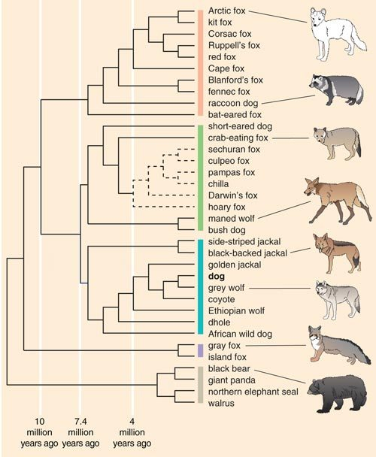
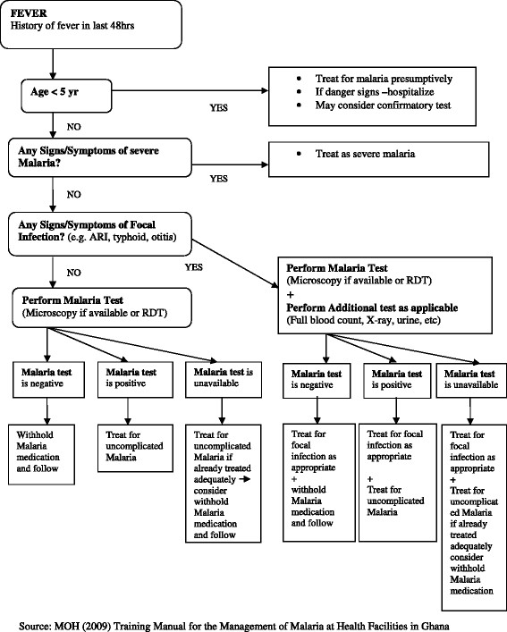
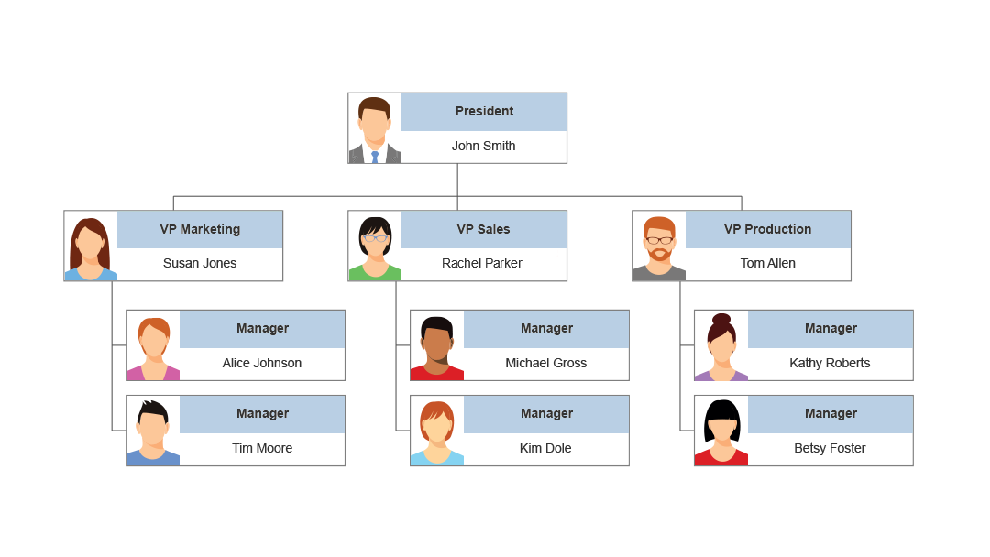
Trees
Trees are a more general concept.
Organization charts.
Family lineages* including phylogenetic trees.
MOH Training Manual for Management of Malaria.
*: Not all family lineages are trees!
Notes:
https://www.smartdraw.com/organizational-chart/org-chart-software.htm
https://www.researchgate.net/figure/Flow-chart-for-the-diagnosis-and-treatment-of-uncomplicated-malaria_fig2_264202517
http://i0.wp.com/barkthink.com/wp-content/uploads/2014/07/barkthink_figure2_canid_species_groups.jpg
https://www.pinterest.com/pin/178244097727550196/

Slide 7
Tree Traversals
Trees
Tree Definition
Tree Traversals
Usefulness of Tree Traversals
Graphs
Graph Definition
Some Famous Graph Problems
Graph Traversals
Motivation: s-t Connectivity
Depth First Search
Tree vs. Graph Traversals
Challenge: Invent Breadth First Search
Lecture 22, CS61B, Spring 2024

Slide 8
Example: File System Tree
Sometimes you want to iterate over a tree. For example, suppose you want to find the total size of all files in a folder called 61b.
What one might call “tree iteration” is actually called “tree traversal.”
Unlike lists, there are many orders in which we might visit the nodes.
Each ordering is useful in different ways.
61b
...
proj0
hw1
...
audio
data
synthesizer
spec
GuitarHeroLite.java
1251 bytes
...
...
...
planets.txt
851 bytes
hw1.md
karplus-strong.png
23433 bytes
16180 bytes

Slide 9
Tree Traversal Orderings
Level Order
Visit top-to-bottom, left-to-right (like reading in English): DBFACEG
D
B
F
A
C
E
G

Slide 10
Tree Traversal Orderings
Level Order
Visit top-to-bottom, left-to-right (like reading in English): DBFACEG
Depth First Traversals
3 types: Preorder, Inorder, Postorder
Basic (rough) idea: Traverse “deep nodes” (e.g. A) before shallow ones (e.g. F).
Note: Traversing a node is different than “visiting” a node. See next slide.
D
B
F
A
C
E
G

Slide 11
Demo: Preorder Depth-First Tree Traversal
Preorder: “Visit” a node, then traverse its children:
preOrder(BSTNode x) {
if (x == null) return; print(x.key) preOrder(x.left) preOrder(x.right) }
Call stack:
preOrder(D)
D
B
F
A
C
E
G

Slide 12
Demo: Preorder Depth-First Tree Traversal
Preorder: “Visit” a node, then traverse its children: D
preOrder(BSTNode x) {
if (x == null) return; print(x.key) preOrder(x.left) preOrder(x.right) }
Call stack:
preOrder(D)
D
B
F
A
C
E
G

Slide 13
Demo: Preorder Depth-First Tree Traversal
Preorder: “Visit” a node, then traverse its children: D
preOrder(BSTNode x) {
if (x == null) return; print(x.key) preOrder(x.left) preOrder(x.right) }
Call stack:
preOrder(D)
D
B
F
A
C
E
G

Slide 14
Demo: Preorder Depth-First Tree Traversal
Preorder: “Visit” a node, then traverse its children: D
preOrder(BSTNode x) {
if (x == null) return; print(x.key) preOrder(x.left) preOrder(x.right) }
Call stack:
preOrder(D)
preOrder(B)
D
B
F
A
C
E
G

Slide 15
Demo: Preorder Depth-First Tree Traversal
Preorder: “Visit” a node, then traverse its children: DB
preOrder(BSTNode x) {
if (x == null) return; print(x.key) preOrder(x.left) preOrder(x.right) }
Call stack:
preOrder(D)
preOrder(B)
D
B
F
A
C
E
G

Slide 16
Demo: Preorder Depth-First Tree Traversal
Preorder: “Visit” a node, then traverse its children: DB
preOrder(BSTNode x) {
if (x == null) return; print(x.key) preOrder(x.left) preOrder(x.right) }
Call stack:
preOrder(D)
preOrder(B)
D
B
F
A
C
E
G

Slide 17
Demo: Preorder Depth-First Tree Traversal
Preorder: “Visit” a node, then traverse its children: DB
preOrder(BSTNode x) {
if (x == null) return; print(x.key) preOrder(x.left) preOrder(x.right) }
Call stack:
preOrder(D)
preOrder(B)
preOrder(A)
D
B
F
A
C
E
G

Slide 18
Demo: Preorder Depth-First Tree Traversal
Preorder: “Visit” a node, then traverse its children: DBA
preOrder(BSTNode x) {
if (x == null) return; print(x.key) preOrder(x.left) preOrder(x.right) }
Call stack:
preOrder(D)
preOrder(B)
preOrder(A)
D
B
F
A
C
E
G

Slide 19
Demo: Preorder Depth-First Tree Traversal
Preorder: “Visit” a node, then traverse its children: DBA
preOrder(BSTNode x) {
if (x == null) return; print(x.key) preOrder(x.left) preOrder(x.right) }
Call stack:
preOrder(D)
preOrder(B)
preOrder(A)
D
Skipping over the steps of preOrder(null) for brevity.
B
F
A
C
E
G

Slide 20
Demo: Preorder Depth-First Tree Traversal
Preorder: “Visit” a node, then traverse its children: DBA
preOrder(BSTNode x) {
if (x == null) return; print(x.key) preOrder(x.left) preOrder(x.right) }
Call stack:
preOrder(D)
preOrder(B)
preOrder(A)
D
Skipping over the steps of preOrder(null) for brevity.
B
F
A
C
E
G

Slide 21
Demo: Preorder Depth-First Tree Traversal
Preorder: “Visit” a node, then traverse its children: DBA
preOrder(BSTNode x) {
if (x == null) return; print(x.key) preOrder(x.left) preOrder(x.right) }
Call stack:
preOrder(D)
preOrder(B)
D
B
F
A
C
E
G

Slide 22
Demo: Preorder Depth-First Tree Traversal
Preorder: “Visit” a node, then traverse its children: DBAC
preOrder(BSTNode x) {
if (x == null) return; print(x.key) preOrder(x.left) preOrder(x.right) }
Call stack:
preOrder(D)
preOrder(B)
D
Skipping over the steps of preOrder(C) for brevity.
B
F
A
C
E
G

Slide 23
Demo: Preorder Depth-First Tree Traversal
Preorder: “Visit” a node, then traverse its children: DBAC
preOrder(BSTNode x) {
if (x == null) return; print(x.key) preOrder(x.left) preOrder(x.right) }
Call stack:
preOrder(D)
D
B
F
A
C
E
G

Slide 24
Demo: Preorder Depth-First Tree Traversal
Preorder: “Visit” a node, then traverse its children: DBAC
preOrder(BSTNode x) {
if (x == null) return; print(x.key) preOrder(x.left) preOrder(x.right) }
Call stack:
preOrder(D)
preOrder(F)
D
B
F
A
C
E
G

Slide 25
Demo: Preorder Depth-First Tree Traversal
Preorder: “Visit” a node, then traverse its children: DBACF
preOrder(BSTNode x) {
if (x == null) return; print(x.key) preOrder(x.left) preOrder(x.right) }
Call stack:
preOrder(D)
preOrder(F)
D
B
F
A
C
E
G

Slide 26
Demo: Preorder Depth-First Tree Traversal
Preorder: “Visit” a node, then traverse its children: DBACFE
preOrder(BSTNode x) {
if (x == null) return; print(x.key) preOrder(x.left) preOrder(x.right) }
Call stack:
preOrder(D)
preOrder(F)
D
Skipping over the steps of preOrder(E) for brevity.
B
F
A
C
E
G

Slide 27
Demo: Preorder Depth-First Tree Traversal
Preorder: “Visit” a node, then traverse its children: DBACFEG
preOrder(BSTNode x) {
if (x == null) return; print(x.key) preOrder(x.left) preOrder(x.right) }
Call stack:
preOrder(D)
preOrder(F)
D
Skipping over the steps of preOrder(G) for brevity.
B
F
A
C
E
G

Slide 28
Depth First Traversals
Preorder traversal: “Visit” a node, then traverse its children: DBACFEG
Inorder traversal: Traverse left child, visit, then traverse right child:
A
B
C
D
E
F
G
preOrder(BSTNode x) {
if (x == null) return; print(x.key) preOrder(x.left) preOrder(x.right) }
inOrder(BSTNode x) {
if (x == null) return; inOrder(x.left) print(x.key)
inOrder(x.right) }
D
B
F
A
C
E
G

Slide 29
Depth First Traversals http://yellkey.com/yes
Preorder traversal: “Visit” a node, then traverse its children: DBACFEG
Inorder traversal: Traverse left child, visit, traverse right child: ABCDEFG
Postorder traversal: Traverse left, traverse right, then visit: ???????
postOrder(BSTNode x) {
if (x == null) return; postOrder(x.left)
postOrder(x.right) print(x.key)
}
DBACEFG
GFEDCBA
GEFCABD
ACBEGFD
ACBFEGD
Other
D
B
F
A
C
E
G
Notes:
https://docs.google.com/forms/d/e/1FAIpQLSfQkN52rJKeURe49gPgjnVFEa5BnaWIXtpoZISkMbO1UQrSQA/viewform

Slide 30
Depth First Traversals
Preorder traversal: “Visit” a node, then traverse its children: DBACFEG
Inorder traversal: Traverse left child, visit, traverse right child: ABCDEFG
Postorder traversal: Traverse left, traverse right, then visit: ACBEGFD
postOrder(BSTNode x) {
if (x == null) return; postOrder(x.left)
postOrder(x.right) print(x.key)
}
DBACEFG
GFEDCBA
GEFCABD
ACBEGFD
ACBFEGD
Other
D
B
F
A
C
E
G

Slide 31
A Useful Visual Trick (for Humans, Not Algorithms)
Preorder traversal: We trace a path around the graph, from the top going counter-clockwise. “Visit” every time we pass the LEFT of a node.
Inorder traversal: “Visit” when you cross the bottom of a node.
Postorder traversal: “Visit” when you cross the right a node.
Example: Post-Order Traversal
4 7 8 5 2 9 6 3 1
1
2
3
4
5
6
7
8
9

Slide 32
Usefulness of Tree Traversals
Trees
Tree Definition
Tree Traversals
Usefulness of Tree Traversals
Graphs
Graph Definition
Some Famous Graph Problems
Graph Traversals
Motivation: s-t Connectivity
Depth First Search
Tree vs. Graph Traversals
Challenge: Invent Breadth First Search
Lecture 22, CS61B, Spring 2024

Slide 33
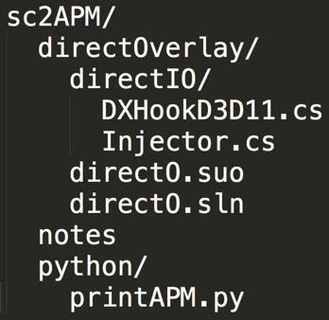
What Good Are All These Traversals?
Example: Preorder Traversal for printing directory listing:
sc2APM
directOverlay
notes
python
directIO
directO.suo
directO.sln
printAPM.py
DXHookD3D11.cs
Injector.cs

Slide 34
What Good Are All These Traversals?
Example: Postorder Traversal for gathering file sizes.
postOrder(BSTNode x) {
if (x == null) return 0; int total = 0;
for (BSTNode c : x.children()) total += postOrder(c) total += x.fileSize();
return total; }
sc2APM
324
directOverlay
notes
python
38912
881
874
directIO
directO.suo
directO.sln
printAPM.py
18381
8798
DXHookD3D11.cs
Injector.cs

Slide 35
What Good Are All These Traversals?
Example: Postorder Traversal for gathering file sizes.
postOrder(BSTNode x) {
if (x == null) return 0; int total = 0;
for (BSTNode c : x.children()) total += postOrder(c) total += x.fileSize();
return total; }
68170
sc2APM
66972
324
874
directOverlay
notes
python
27179
38912
881
874
directIO
directO.suo
directO.sln
printAPM.py
18381
8798
DXHookD3D11.cs
Injector.cs

Slide 36
Graph Definition
Trees
Tree Definition
Tree Traversals
Usefulness of Tree Traversals
Graphs
Graph Definition
Some Famous Graph Problems
Graph Traversals
Motivation: s-t Connectivity
Depth First Search
Tree vs. Graph Traversals
Challenge: Invent Breadth First Search
Lecture 22, CS61B, Spring 2024

Slide 37
Trees and Hierarchical Relationships
Trees are fantastic for representing strict hierarchical relationships.
But not every relationship is hierarchical.
Example: Paris Metro map.
This is not a tree: Contains cycles!
More than one way to get from A to B.
B
A

Slide 38
Tree Definition (Revisited)
A tree consists of:
A set of nodes.
A set of edges that connect those nodes.
Constraint: There is exactly one path between any two nodes.
Green structures on slide are trees. Pink ones are not.

Slide 39
Graph Definition
A graph consists of:
A set of nodes.
A set of zero or more edges, each of which connects two nodes.
Green structures below are graphs.
Note, all trees are graphs!

Slide 40
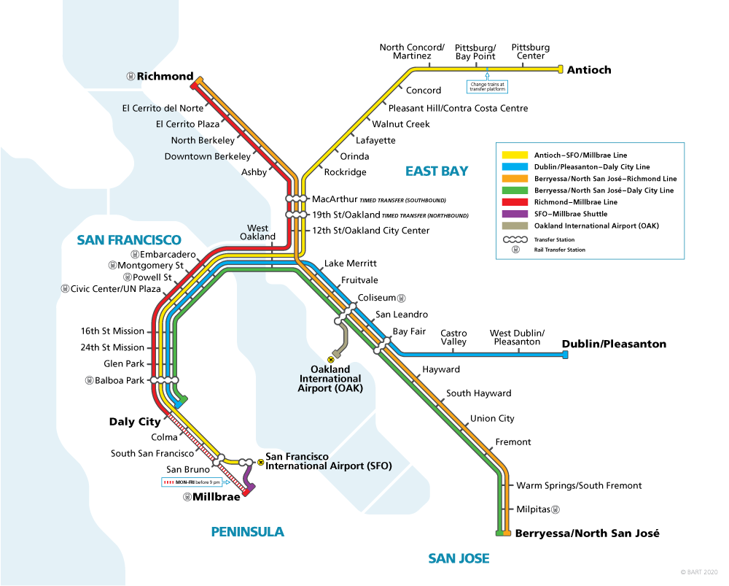
Graph Example: BART
Is the BART graph a tree?
No, has one cycle.
San Bruno
SFO
Millbrae
Notes:
bart.gov

Slide 41
Graph Definition
A simple graph is a graph with:
No edges that connect a vertex to itself, i.e. no “length 1 loops”.
No two edges that connect the same vertices, i.e. no “parallel edges”.
Green graph below is simple, pink graphs are not.

Slide 42
Graph Definition
A simple graph is a graph with:
No edges that connect a vertex to itself, i.e. no “loops”.
No two edges that connect the same vertices, i.e. no “parallel edges”.
In 61B, unless otherwise explicitly stated, all graphs will be simple.
In other words, when we say “graph”, we mean “simple graph.”

Slide 43
Graph Types
Directed
Undirected
b
b
e
With Edge Labels
Acyclic:
a
d
a
d
b
3
e
c
c
1
1
a
d
2
b
b
c
Cyclic:
a
d
a
d
c
c

Slide 44
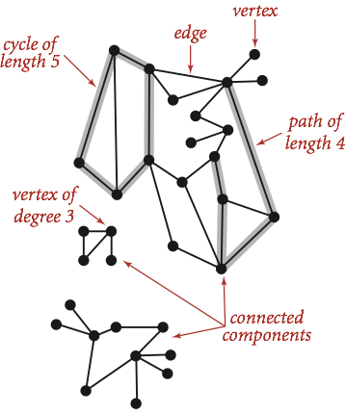
Graph Terminology
Graph:
Set of vertices, a.k.a. nodes.
Set of edges: Pairs of vertices.
Vertices with an edge between are adjacent.
Optional: Vertices or edges may have labels (or weights).
A path is a sequence of vertices connected by edges.
A simple path is a path without repeated vertices.
A cycle is a path whose first and last vertices are the same.
A graph with a cycle is ‘cyclic’.
Two vertices are connected if there is a path between them. If all vertices are connected, we say the graph is connected.
Figure from Algorithms 4th Edition

Slide 45
Graph Example: The Paris Metro
This schematic map of the Paris Metro is a graph:
Undirected
Connected
Cyclic (not a tree!)
Vertex-labeled (each has a color).
Notes:
http://www.martingrandjean.ch/wp-content/uploads/2013/07/Gephi5.png

Slide 46
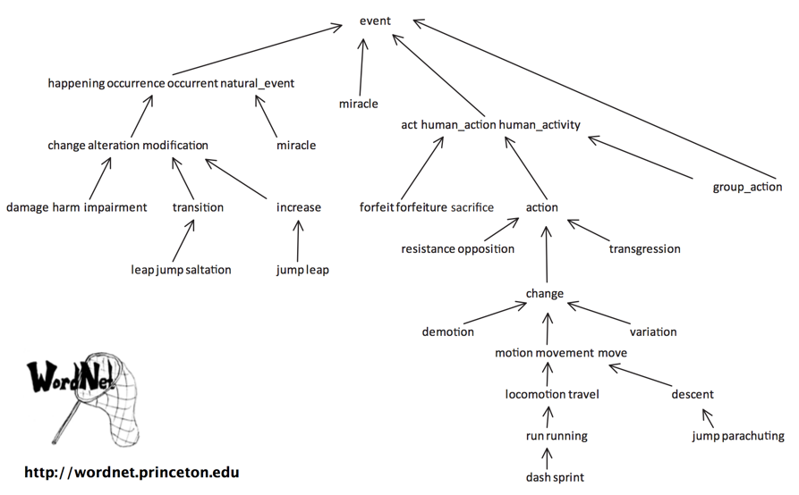
Directed Graph Example
Not a tree!
Two paths from group_action to event.
Edge captures ‘is-a-type-of’ relationship. Example: descent is-a-type-of movement.

Slide 47
Some Famous Graph Problems
Trees
Tree Definition
Tree Traversals
Usefulness of Tree Traversals
Graphs
Graph Definition
Some Famous Graph Problems
Graph Traversals
Motivation: s-t Connectivity
Depth First Search
Tree vs. Graph Traversals
Challenge: Invent Breadth First Search
Lecture 22, CS61B, Spring 2024

Slide 48
Graph Queries
There are lots of interesting questions we can ask about a graph:
What is the shortest route from S to T? What is the longest without cycles?
Are there cycles?
Is there a tour you can take that only uses each node (station) exactly once?
Is there a tour that uses each edge exactly once?
T
S
Notes:
http://www.martingrandjean.ch/wp-content/uploads/2013/07/Gephi5.png

Slide 49
Graph Queries More Theoretically
Some well known graph problems and their common names:
s-t Path. Is there a path between vertices s and t?
Connectivity. Is the graph connected, i.e. is there a path between all vertices?
Biconnectivity. Is there a vertex whose removal disconnects the graph?
Shortest s-t Path. What is the shortest path between vertices s and t?
Cycle Detection. Does the graph contain any cycles?
Euler Tour. Is there a cycle that uses every edge exactly once?
Hamilton Tour. Is there a cycle that uses every vertex exactly once?
Planarity. Can you draw the graph on paper with no crossing edges?
Isomorphism. Are two graphs isomorphic (the same graph in disguise)?
Often can’t tell how difficult a graph problem is without very deep consideration.

Slide 50
Graph Problem Difficulty
Some well known graph problems:
Euler Tour. Is there a cycle that uses every edge exactly once?
Hamilton Tour. Is there a cycle that uses every vertex exactly once?
Difficulty can be deceiving.
An efficient Euler tour algorithm O(# edges) was found as early as 1873 [Link].
Despite decades of intense study, no efficient algorithm for a Hamilton tour exists. Best algorithms are exponential time.
Graph problems are among the most mathematically rich areas of CS theory.

Slide 51
Motivation for Graph Traversals: s-t Connectivity
Trees
Tree Definition
Tree Traversals
Usefulness of Tree Traversals
Graphs
Graph Definition
Some Famous Graph Problems
Graph Traversals
Motivation: s-t Connectivity
Depth First Search
Tree vs. Graph Traversals
Challenge: Invent Breadth First Search
Lecture 22, CS61B, Spring 2024

Slide 52
s-t Connectivity
Let’s solve a classic graph problem called the s-t connectivity problem.
Given source vertex s and a target vertex t, is there a path between s and t?
Requires us to traverse the graph somehow.
3
0
1
4
6
s
2
5
7
t
8

Slide 53
s-t Connectivity
Let’s solve a classic graph problem called the s-t connectivity problem.
Given source vertex s and a target vertex t, is there a path between s and t?
Requires us to traverse the graph somehow.
Try to come up with an algorithm for connected(s, t).
3
0
1
4
6
s
2
5
7
t
8

Slide 54
s-t Connectivity
One possible recursive algorithm for connected(s, t).
Does s == t? If so, return true.
Otherwise, if connected(v, t) for any neighbor v of s, return true.
Return false.
What is wrong with the algorithm above?
3
0
1
4
6
s
2
5
7
t
8

Slide 55
s-t Connectivity
One possible recursive algorithm for connected(s, t).
Does s == t? If so, return true.
Otherwise, if connected(v, t) for any neighbor v of s, return true.
Return false.
What is wrong with the algorithm above?
3
0
1
4
6
s
2
5
7
t
8

Slide 56
s-t Connectivity
One possible recursive algorithm for connected(s, t).
Does s == t? If so, return true.
Otherwise, if connected(v, t) for any neighbor v of s, return true.
Return false.
What is wrong with it? Can get caught in an infinite loop. Example:
connected(0, 7):
Does 0 == 7? No, so...
if (connected(1, 7)) return true;
connected(1, 7):
Does 1 == 7? No, so…
If (connected(0, 7)) … ← Infinite loop.
3
0
1
4
6
s
2
5
7
t
8

Slide 57
s-t Connectivity
One possible recursive algorithm for connected(s, t).
Does s == t? If so, return true.
Otherwise, if connected(v, t) for any neighbor v of s, return true.
Return false.
What is wrong with it? Can get caught in an infinite loop.
How do we fix it?
3
0
1
4
6
s
2
5
7
t
8

Slide 58
Depth First Search
Trees
Tree Definition
Tree Traversals
Usefulness of Tree Traversals
Graphs
Graph Definition
Some Famous Graph Problems
Graph Traversals
Motivation: s-t Connectivity
Depth First Search
Tree vs. Graph Traversals
Challenge: Invent Breadth First Search
Lecture 22, CS61B, Spring 2024

Slide 59
s-t Connectivity
One possible recursive algorithm for connected(s, t).
Mark s.
Does s == t? If so, return true.
Otherwise, if connected(v, t) for any unmarked neighbor v of s, return true.
Return false.
Basic idea is same as before, but visit each vertex at most once.
Marking nodes prevents multiple visits.
3
0
1
4
6
s
2
5
7
t
8

Slide 60
Demo: s-t Connectivity
connected(s, t):
Mark s.
Does s == t? If so, return true.
Otherwise, if connected(v, t) for any unmarked neighbor v of s, return true.
Return false.
3
0
1
4
6
s
2
5
7
t
8

Slide 61
Demo: s-t Connectivity
connected(s, t):
Mark s.
Does s == t? If so, return true.
Otherwise, if connected(v, t) for any unmarked neighbor v of s, return true.
Return false.
Call stack: 0
mark(0).
Is 0 == 7? No.
isMarked(1)? No.
Check connected(1, 7).
3
*
0
1
4
6
s
2
5
7
t
8

Slide 62
Demo: s-t Connectivity
connected(s, t):
Mark s.
Does s == t? If so, return true.
Otherwise, if connected(v, t) for any unmarked neighbor v of s, return true.
Return false.
Call stack: 0 → 1
mark(1).
Is 1 == 7? No.
isMarked(0)? Yes.
isMarked(2)?
Check connected(2, 7).
3
*
0
1
4
6
s
2
5
7
t
8

Slide 63
Demo: s-t Connectivity
connected(s, t):
Mark s.
Does s == t? If so, return true.
Otherwise, if connected(v, t) for any unmarked neighbor v of s, return true.
Return false.
Call stack: 0 → 1 → 2
mark(2).
Is 2 == 7? No.
isMarked(1)? Yes.
isMarked(5)?
Check connected(5, 7).
3
0
1
4
6
s
*
2
5
7
t
8

Slide 64
Demo: s-t Connectivity
connected(s, t):
Mark s.
Does s == t? If so, return true.
Otherwise, if connected(v, t) for any unmarked neighbor v of s, return true.
Return false.
Call stack: 0 → 1 → 2 → 5
mark(5).
Is 5 == 7? No.
isMarked(2)? Yes.
isMarked(4)?
Check connected(4, 7).
3
0
1
4
6
s
*
2
5
7
t
8

Slide 65
Demo: s-t Connectivity
connected(s, t):
Mark s.
Does s == t? If so, return true.
Otherwise, if connected(v, t) for any unmarked neighbor v of s, return true.
Return false.
Call stack: 0 → 1 → 2 → 5 → 4
mark(4).
Is 4 == 7? No.
isMarked(1)? Yes.
isMarked(3)? No.
Check connected(3, 7).
3
*
0
1
4
6
s
2
5
7
t
8

Slide 66
Demo: s-t Connectivity
connected(s, t):
Mark s.
Does s == t? If so, return true.
Otherwise, if connected(v, t) for any unmarked neighbor v of s, return true.
Return false.
Call stack: 0 → 1 → 2 → 5 → 4 → 3
*
mark(3).
Is 3 == 7? No.
isMarked(4)? Yes.
No more neighbors! Return false.
3
0
1
4
6
s
2
5
7
t
8

Slide 67

Demo: s-t Connectivity
connected(s, t):
Mark s.
Does s == t? If so, return true.
Otherwise, if connected(v, t) for any unmarked neighbor v of s, return true.
Return false.
Call stack: 0 → 1 → 2 → 5 → 4
mark(4).
Is 4 == 7? No.
isMarked(1)? Yes.
isMarked(3)? No.
Check connected(3, 7). Answer was false.
isMarked(5)? Yes.
No more neighbors, so return false.
3
*
0
1
4
6
s
2
5
7
t
8
Notes:
https://dlpng.com/png/200550

Slide 68
Demo: s-t Connectivity
connected(s, t):
Mark s.
Does s == t? If so, return true.
Otherwise, if connected(v, t) for any unmarked neighbor v of s, return true.
Return false.
Call stack: 0 → 1 → 2 → 5
mark(5).
Is 5 == 7? No.
isMarked(2)? Yes.
isMarked(4)?
Check connected(4, 7). Answer was false, so keep checking neighbors.
isMarked(6)?
Check connected(6, 7).
3
0
1
4
6
s
*
2
5
7
t
8

Slide 69
Demo: s-t Connectivity
connected(s, t):
Mark s.
Does s == t? If so, return true.
Otherwise, if connected(v, t) for any unmarked neighbor v of s, return true.
Return false.
Call stack: 0 → 1 → 2 → 5 → 6
mark(6).
Is 6 == 7? No.
isMarked(5)? Yes.
isMarked(7)? No.
Check connected(7, 7).
3
*
0
1
4
6
s
2
5
7
t
8

Slide 70
Demo: s-t Connectivity
connected(s, t):
Mark s.
Does s == t? If so, return true.
Otherwise, if connected(v, t) for any unmarked neighbor v of s, return true.
Return false.
Call stack: 0 → 1 → 2 → 5 → 6 → 7
mark(7).
Is 7 == 7? Yes. Return true!
3
0
1
4
6
s
*
2
5
7
t
8

Slide 71

Demo: s-t Connectivity
connected(s, t):
Mark s.
Does s == t? If so, return true.
Otherwise, if connected(v, t) for any unmarked neighbor v of s, return true.
Return false.
Call stack: 0 → 1 → 2 → 5 → 6
mark(6).
Is 6 == 7? No.
isMarked(5)? Yes.
isMarked(7)? No.
Check connected(7, 7). Answer was true, so return true.
3
*
0
1
4
6
s
2
5
7
t
8

Slide 72
Demo: s-t Connectivity
connected(s, t):
Mark s.
Does s == t? If so, return true.
Otherwise, if connected(v, t) for any unmarked neighbor v of s, return true.
Return false.
Call stack: 0 → 1 → 2 → 5
mark(5).
Is 5 == 7? No.
isMarked(2)? Yes.
isMarked(4)?
Check connected(4, 7). Answer was false, so keep checking neighbors.
isMarked(5)? Yes.
isMarked(6)?
Check connected(6, 7): Return true!
3
0
1
4
6
s
*
2
5
7
t
8

Slide 73
Demo: s-t Connectivity
connected(s, t):
Mark s.
Does s == t? If so, return true.
Otherwise, if connected(v, t) for any unmarked neighbor v of s, return true.
Return false.
Call stack: 0 → 1 → 2
mark(2).
Is 2 == 7? No.
isMarked(1)? Yes.
isMarked(5)?
Check connected(5, 7). Answer was true, so return true!
3
0
1
4
6
s
*
2
5
7
t
8

Slide 74
Demo: s-t Connectivity
connected(s, t):
Mark s.
Does s == t? If so, return true.
Otherwise, if connected(v, t) for any unmarked neighbor v of s, return true.
Return false.
Call stack: 0 → 1
mark(1).
Is 1 == 7? No.
isMarked(0)? Yes.
isMarked(2)?
Check connected(2, 7). Answer was true, so return true!
3
*
0
1
4
6
s
2
5
7
t
8

Slide 75
Demo: s-t Connectivity
connected(s, t):
Mark s.
Does s == t? If so, return true.
Otherwise, if connected(v, t) for any unmarked neighbor v of s, return true.
Return false.
Call stack: 0
mark(0).
Is 0 == 7? No.
isMarked(1)? No.
Check connected(1, 7). Answer was true, so return true!
3
*
0
1
4
6
s
2
5
7
t
8

Slide 76
Demo: s-t Connectivity
connected(s, t):
Mark s.
Does s == t? If so, return true.
Otherwise, if connected(v, t) for any unmarked neighbor v of s, return true.
Return false.
mark(0).
Is 0 == 7? No.
isMarked(1)? No.
Check connected(1, 7). Answer was true, so return true!
3
*
0
1
4
6
s
2
5
7
t
8

Slide 77
Depth First Traversal
This idea of exploring a neighbor’s entire subgraph before moving on to the next neighbor is known as Depth First Traversal or Depth First Search.
Example: Explore 1’s subgraph completely before using the edge 0-3.
Called “depth first” because you go as deep as possible.
s
0
1
3
4
7
2
8
t
5
6

Slide 78
Depth First Traversal
This idea of exploring a neighbor’s entire subgraph before moving on to the next neighbor is known as Depth First Traversal.
Example: Explore 1’s subgraph completely before using the edge 0-3.
Called “depth first” because you go as deep as possible.
s
0
1
3
4
7
2
8
t
Entirely possible for 1’s subgraph to include 3!
It’s still depth first, since we’re not using the edge 0-3 until the subgraph is explored.
5
6

Slide 79
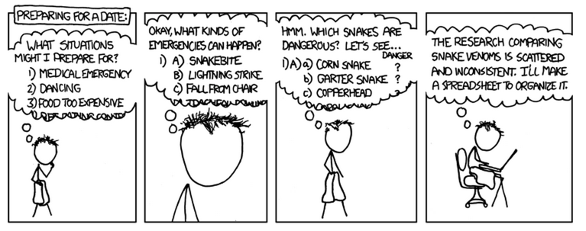
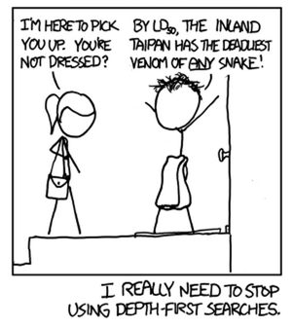
From: https://xkcd.com/761/

Slide 80
The Power of Depth First Search
DFS is a very powerful technique that can be used for many types of graph problems.
Another example:
Let’s discuss an algorithm that computes a path to every vertex.
Let’s call this algorithm DepthFirstPaths.
Goal: Find a path from s to every other reachable vertex, visiting each vertex at most once.

Slide 81
Demo: DepthFirstPaths
dfs(v):
Mark v.
For each unmarked adjacent vertex w:
set edgeTo[w] = v.
dfs(w)
Call stack:
dfs(0)
Order of dfs calls: 0
# marked edgeTo
0 F -
1 F -
2 F -
3 F -
4 F -
5 F -
6 F -
7 F -
8 F -
Start by calling dfs(0).
3
0
1
4
6
s
2
5
7
8
Order of dfs returns:

Slide 82
Demo: DepthFirstPaths
dfs(v):
Mark v.
For each unmarked adjacent vertex w:
set edgeTo[w] = v.
dfs(w)
Call stack:
dfs(0)
Order of dfs calls: 01
# marked edgeTo
0 T -
1 F 0
2 F -
3 F -
4 F -
5 F -
6 F -
7 F -
8 F -
dfs(0):
mark(0).
isMarked(1)? No.
edgeTo[1] = 0. dfs(1).
3
*
0
1
4
6
s
2
5
7
8
Order of dfs returns:

Slide 83
Demo: DepthFirstPaths
dfs(v):
Mark v.
For each unmarked adjacent vertex w:
set edgeTo[w] = v.
dfs(w)
Call stack:
dfs(0) → dfs(1)
Order of dfs calls: 012
# marked edgeTo
0 T -
1 T 0
2 F 1
3 F -
4 F -
5 F -
6 F -
7 F -
8 F -
dfs(1):
mark(1).
isMarked(0)? Yes.
isMarked(2)? No.
edgeTo[2] = 1. dfs(2).
3
*
0
1
4
6
s
2
5
7
8
Order of dfs returns:

Slide 84
Demo: DepthFirstPaths
dfs(v):
Mark v.
For each unmarked adjacent vertex w:
set edgeTo[w] = v.
dfs(w)
Call stack:
dfs(0) → dfs(1) → dfs(2)
Order of dfs calls: 0125
# marked edgeTo
0 T -
1 T 0
2 T 1
3 F -
4 F -
5 F 2
6 F -
7 F -
8 F -
dfs(2):
mark(2).
isMarked(1)? Yes.
isMarked(5)? No.
edgeTo[5] = 2. dfs(5).
3
0
1
4
6
s
*
2
5
7
8
Order of dfs returns:

Slide 85
Demo: DepthFirstPaths
dfs(v):
Mark v.
For each unmarked adjacent vertex w:
set edgeTo[w] = v.
dfs(w)
Call stack:
dfs(0) → dfs(1) → dfs(2) → dfs(5)
Order of dfs calls: 01254
# marked edgeTo
0 T -
1 T 0
2 T 1
3 F -
4 F 5
5 T 2
6 F -
7 F -
8 F -
dfs(5):
mark(5).
isMarked(2)? Yes.
isMarked(4)? No.
edgeTo[4] = 5. dfs(4).
3
0
1
4
6
s
*
2
5
7
8
Order of dfs returns:

Slide 86
Demo: DepthFirstPaths
dfs(v):
Mark v.
For each unmarked adjacent vertex w:
set edgeTo[w] = v.
dfs(w)
Call stack:
dfs(0) → dfs(1) → dfs(2) → dfs(5) → dfs(4)
Order of dfs calls: 012543
# marked edgeTo
0 T -
1 T 0
2 T 1
3 F 4
4 T 5
5 T 2
6 F -
7 F -
8 F -
dfs(4):
mark(4).
isMarked(1)? Yes.
isMarked(3)? No.
edgeTo[3] = 4. dfs(3).
3
*
0
1
4
6
s
2
5
7
8
Order of dfs returns:

Slide 87
Demo: DepthFirstPaths
dfs(v):
Mark v.
For each unmarked adjacent vertex w:
set edgeTo[w] = v.
dfs(w)
Call stack:
dfs(0) → dfs(1) → dfs(2) → dfs(5) → dfs(4) → dfs(3)
Order of dfs calls: 012543
# marked edgeTo
0 T -
1 T 0
2 T 1
3 T 4
4 T 5
5 T 2
6 F -
7 F -
8 F -
dfs(3):
*
mark(3).
isMarked(4)? Yes.
No more children, so return.
3
0
1
4
6
s
2
5
7
8
Order of dfs returns: 3

Slide 88
Demo: DepthFirstPaths
dfs(v):
Mark v.
For each unmarked adjacent vertex w:
set edgeTo[w] = v.
dfs(w)
Call stack:
dfs(0) → dfs(1) → dfs(2) → dfs(5) → dfs(4)
Order of dfs calls: 012543
# marked edgeTo
0 T -
1 T 0
2 T 1
3 T 4
4 T 5
5 T 2
6 F -
7 F -
8 F -
dfs(4):
mark(4).
isMarked(3)? No.
edgeTo[3] = 4. dfs(3).
No more children, so return.
3
*
0
1
4
6
s
2
5
7
8
Order of dfs returns: 34

Slide 89
Demo: DepthFirstPaths
dfs(v):
Mark v.
For each unmarked adjacent vertex w:
set edgeTo[w] = v.
dfs(w)
Call stack:
dfs(0) → dfs(1) → dfs(2) → dfs(5)
Order of dfs calls: 0125436
# marked edgeTo
0 T -
1 T 0
2 T 1
3 T 4
4 T 5
5 T 2
6 F 5
7 F -
8 F -
dfs(5):
mark(5).
isMarked(2)? Yes.
isMarked(4)? No.
edgeTo[3] = 4. dfs(4).
isMarked(6)? No.
edgeTo[6] = 5. dfs(6).
3
0
1
4
6
s
*
2
5
7
8
Order of dfs returns: 34

Slide 90
Demo: DepthFirstPaths
dfs(v):
Mark v.
For each unmarked adjacent vertex w:
set edgeTo[w] = v.
dfs(w)
Call stack:
dfs(0) → dfs(1) → dfs(2) → dfs(5) → dfs(6)
Order of dfs calls: 01254367
# marked edgeTo
0 T -
1 T 0
2 T 1
3 T 4
4 T 5
5 T 2
6 T 5
7 F 6
8 F -
dfs(6):
mark(6).
isMarked(5)? Yes.
isMarked(7)? No.
edgeTo[7] = 6. dfs(7).
3
*
0
1
4
6
s
2
5
7
8
Order of dfs returns: 34

Slide 91
Demo: DepthFirstPaths
dfs(v):
Mark v.
For each unmarked adjacent vertex w:
set edgeTo[w] = v.
dfs(w)
Call stack:
dfs(0) → dfs(1) → dfs(2) → dfs(5) → dfs(6) → dfs(7)
Order of dfs calls: 01254367
# marked edgeTo
0 T -
1 T 0
2 T 1
3 T 4
4 T 5
5 T 2
6 T 5
7 T 6
8 F -
dfs(7):
mark(7).
isMarked(6)? Yes.
No more children, so return.
3
0
1
4
6
s
*
2
5
7
8
Order of dfs returns: 347

Slide 92
Demo: DepthFirstPaths
dfs(v):
Mark v.
For each unmarked adjacent vertex w:
set edgeTo[w] = v.
dfs(w)
Call stack:
dfs(0) → dfs(1) → dfs(2) → dfs(5) → dfs(6)
Order of dfs calls: 01254367
# marked edgeTo
0 T -
1 T 0
2 T 1
3 T 4
4 T 5
5 T 2
6 T 5
7 T 6
8 F -
dfs(6):
mark(6).
isMarked(5)? Yes.
isMarked(7)? No.
edgeTo[7] = 6. dfs(7).
No more children, so return.
3
*
0
1
4
6
s
2
5
7
8
Order of dfs returns: 3476

Slide 93
Demo: DepthFirstPaths
dfs(v):
Mark v.
For each unmarked adjacent vertex w:
set edgeTo[w] = v.
dfs(w)
Call stack:
dfs(0) → dfs(1) → dfs(2) → dfs(5)
Order of dfs calls: 012543678
# marked edgeTo
0 T -
1 T 0
2 T 1
3 T 4
4 T 5
5 T 2
6 T 5
7 T 6
8 F 5
dfs(5):
mark(5).
isMarked(2)? Yes.
isMarked(4)? No.
edgeTo[3] = 4. dfs(4).
isMarked(6)? No.
edgeTo[6] = 5. dfs(6).
isMarked(8)? No.
edgeTo[8] = 5. dfs(8).
3
0
1
4
6
s
*
2
5
7
8
Order of dfs returns: 3476

Slide 94
Demo: DepthFirstPaths
dfs(v):
Mark v.
For each unmarked adjacent vertex w:
set edgeTo[w] = v.
dfs(w)
Call stack:
dfs(0) → dfs(1) → dfs(2) → dfs(5) → dfs(8)
Order of dfs calls: 012543678
# marked edgeTo
0 T -
1 T 0
2 T 1
3 T 4
4 T 5
5 T 2
6 T 5
7 T 6
8 T 5
dfs(8):
mark(8)
isMarked(5)? Yes.
No more children, so return.
3
0
1
4
6
s
2
5
7
*
8
Order of dfs returns: 34768

Slide 95
Demo: DepthFirstPaths
dfs(v):
Mark v.
For each unmarked adjacent vertex w:
set edgeTo[w] = v.
dfs(w)
Call stack:
dfs(0) → dfs(1) → dfs(2) → dfs(5)
Order of dfs calls: 012543678
# marked edgeTo
0 T -
1 T 0
2 T 1
3 T 4
4 T 5
5 T 2
6 T 5
7 T 6
8 T 5
dfs(5):
mark(5).
isMarked(2)? Yes.
isMarked(4)? No.
edgeTo[3] = 4. dfs(4).
isMarked(6)? No.
edgeTo[6] = 5. dfs(6).
isMarked(8)? No.
edgeTo[8] = 5. dfs(8)
No more children, so return.
3
0
1
4
6
s
*
2
5
7
8
Order of dfs returns: 347685

Slide 96
Demo: DepthFirstPaths
dfs(v):
Mark v.
For each unmarked adjacent vertex w:
set edgeTo[w] = v.
dfs(w)
Call stack:
dfs(0) → dfs(1) → dfs(2)
Order of dfs calls: 012543678
# marked edgeTo
0 T -
1 T 0
2 T 1
3 T 4
4 T 5
5 T 2
6 T 5
7 T 6
8 T 5
dfs(2):
mark(2).
isMarked(1)? Yes.
isMarked(5)? No.
edgeTo[5] = 2. dfs(5).
No more children, so return.
3
0
1
4
6
s
*
2
5
7
8
Order of dfs returns: 3476852

Slide 97
Demo: DepthFirstPaths
dfs(v):
Mark v.
For each unmarked adjacent vertex w:
set edgeTo[w] = v.
dfs(w)
Call stack:
dfs(0) → dfs(1)
Order of dfs calls: 012543678
# marked edgeTo
0 T -
1 T 0
2 T 1
3 T 4
4 T 5
5 T 2
6 T 5
7 T 6
8 T 5
dfs(1):
mark(1).
isMarked(0)? Yes.
isMarked(2)? No.
edgeTo[2] = 1. dfs(2).
isMarked(4)? Yes.
No more children, so return.
3
*
0
1
4
6
s
2
5
7
8
Order of dfs returns: 34768521

Slide 98
Demo: DepthFirstPaths
dfs(v):
Mark v.
For each unmarked adjacent vertex w:
set edgeTo[w] = v.
dfs(w)
Call stack:
dfs(0)
Order of dfs calls: 012543678
# marked edgeTo
0 T -
1 T 0
2 T 1
3 T 4
4 T 5
5 T 2
6 T 5
7 T 6
8 T 5
dfs(0):
mark(0).
isMarked(1)? No.
edgeTo[1] = 0. dfs(1).
No more children, so return.
3
*
0
1
4
6
s
2
5
7
8
Order of dfs returns: 347685210

Slide 99
Tree vs. Graph Traversals
Trees
Tree Definition
Tree Traversals
Usefulness of Tree Traversals
Graphs
Graph Definition
Some Famous Graph Problems
Graph Traversals
Motivation: s-t Connectivity
Depth First Search
Tree vs. Graph Traversals
Challenge: Invent Breadth First Search
Lecture 22, CS61B, Spring 2024

Slide 100
Tree Traversals
There are many tree traversals:
Preorder: DBACFEG
Inorder: ABCDEFG
Postorder: ACBEGFD
Level order: DBFACEG
D
B
F
A
C
E
G

Slide 101
Graph Traversals
There are many tree traversals:
Preorder: DBACFEG
Inorder: ABCDEFG
Postorder: ACBEGFD
Level order: DBFACEG
D
B
F
A
C
E
G
What we just did in DepthFirstPaths is called “DFS Preorder.”
DFS Preorder: Action is before DFS calls to neighbors.
Our action was setting edgeTo.
Example: edgeTo[1] was set before DFS calls to neighbors 2 and 4.
One valid DFS preorder for this graph: 012543678
Equivalent to the order of dfs calls.
3
0
1
4
6
s
2
5
7
8

Slide 102
Graph Traversals
There are many tree traversals:
Preorder: DBACFEG
Inorder: ABCDEFG
Postorder: ACBEGFD
Level order: DBFACEG
D
B
F
A
C
E
G
Could also do actions in DFS Postorder.
DFS Postorder: Action is after DFS calls to neighbors.
Example: dfs(s):
mark(s)
For each unmarked neighbor n of s, dfs(n)
print(s)
Results for dfs(0) would be: 347685210
Equivalent to the order of dfs returns.
3
0
1
4
6
s
2
5
7
8

Slide 103
Graph Traversals
Just as there are many tree traversals:
Preorder: DBACFEG
Inorder: ABCDEFG
Postorder: ACBEGFD
Level order: DBFACEG
D
B
F
A
C
E
G
So too are there many graph traversals, given some source:
DFS Preorder: 012543678 (dfs calls).
DFS Postorder: 347685210 (dfs returns).
3
0
1
4
6
s
2
5
7
8

Slide 104
Graph Traversals
Just as there are many tree traversals:
Preorder: DBACFEG
Inorder: ABCDEFG
Postorder: ACBEGFD
Level order: DBFACEG
D
B
F
A
C
E
G
So too are there many graph traversals, given some source:
DFS Preorder: 012543678 (dfs calls).
DFS Postorder: 347685210 (dfs returns).
BFS order: Act in order of distance from s.
BFS stands for “breadth first search”.
Analogous to “level order”. Search is wide, not deep.
0 1 24 53 68 7
3
0
1
4
6
s
2
5
7
8

Slide 105
Challenge: Invent Breadth First Search
Trees
Tree Definition
Tree Traversals
Usefulness of Tree Traversals
Graphs
Graph Definition
Some Famous Graph Problems
Graph Traversals
Motivation: s-t Connectivity
Depth First Search
Tree vs. Graph Traversals
Challenge: Invent Breadth First Search
Lecture 22, CS61B, Spring 2024

Slide 106
Shortest Paths Challenge Before Next Lecture
2
s
0
3
5
1
4
6
7
Goal: Given the graph above, find the length of the shortest path from s to all other vertices.
Give a general algorithm.
Hint: You’ll need to somehow visit vertices in BFS order.
Hint #2: You’ll need to use some kind of data structure.
Will discuss a solution in the next lecture.

Slide 107
Summary
Graphs are a more general idea than a tree.
A tree is a graph where there are no cycles and every vertex is connected.
Key graph terms: Directed, Undirected, Cyclic, Acyclic, Path, Cycle.
Graph problems vary widely in difficulty.
Common tool for solving almost all graph problems is traversal.
A traversal is an order in which you visit / act upon vertices.
Tree traversals:
Preorder, inorder, postorder, level order.
Graph traversals:
DFS preorder, DFS postorder, BFS.
By performing actions / setting instance variables during a graph (or tree) traversal, you can solve problems like s-t connectivity or path finding.

